Slide 1
Data Flow Diagrams and Entity Relationship Diagrams
Session 09
(Lecture)
Course : Program Design Methods
Effective Period : July 2018

Slide 2
These slides have been adapted from
Systems Analysis & Design, Alan Dennis, Barbara Haley Wixom, Roberta M.Roth, Fifth Edition,
Course Technology. ISBN: 13 978-0-470.22854-8. Chapter 5
Acknowledgement

Slide 3
LO 4 : Demonstrate the use of program design method
Learning Objectives

Slide 4
Contents
Introduction Data Flow Diagram (DFD)
Reading Data Flow Diagrams
Elements of Data Flow Diagrams
Using Data Flow Diagrams to Define Business Processes
Process Descriptions
Introduction Crating Data Flow Diagrams
Creating the Context Diagram
Creating Data Flow Diagram Fragments
Creating the Level 0 data Flow Diagram
Creating the Level 1 Data Flow Diagram
Validating the Data Flow Diagram

Slide 5
Contents
Introduction Entity Relationship Diagram (ERD)
Reading an Entity Relationship Diagram
Elements of an Entity Relationship Diagram
The Data Dictionary and Metadata
Introduction Creating ERD
Building Entity Relationship Diagram
Advanced Syntax

Slide 6
Reading Data Flow Diagrams

Slide 7
Introduction DFD
Data Flow Diagram (DFD) is a technique that diagrams the business processes and the data that pass among them
The DFD is a conceptual model – it doesn’t represent the computer program, it represents what the program must accomplish.
By showing the input and output of each major task, it shows how data must move through and be transformed by the program.

Slide 8
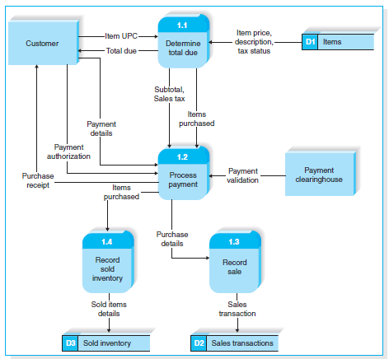
Reading Data Flow Diagram
DFD for the process of buying goods at the supermarket

Slide 9
Reading Data Flow Diagram
By examining the DFD, an analyst can understand the process by which customers checkout at the supermarket.

Slide 10
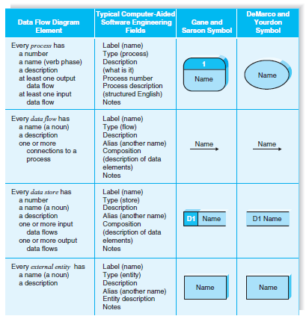
Elements Data Flow Diagram

Slide 11
Reading Data Flow Diagram
Process
Process is an activity or a function that is performed for some specific business reason
Every process should be named starting with a verb and ending with a noun (e.g., “Determine total due”)
Process must have at least one input data flow and at least one output data flow

Slide 12
Reading Data Flow Diagram
Data Flow
Data flow is a single piece of data (e.g., item UPC), or a logical collection of several pieces of information (e.g., purchase receipt)
Every data flow should be named with a noun

Slide 13
Reading Data Flow Diagram
Data Store
Data store is a collection of data that is stored in some way (which is determined later when creating the physical model)
Every data store is named with a noun and is assigned an identification number and a description.

Slide 14
Reading Data Flow Diagram
External Entity
External entity is a person, organization, or system that is external to the system, but interacts with it (e.g., sustemer, clearinghouse, government organization, accounting system)
External entities provide data to the system or receive data from the system, and serve to establish the system boundaries

Slide 15
Using Data Flow Diagram to Define Business Processes
Most business processes are too complex to be explained in one DFD.
Most process models are therefore composed of a set of DFDs.
The first DFD provides a summary of the overall system, with additional DFDs providing more and more detail about each part of the overall business process.
Thus, one important principle in process modeling with DFDs is the decomposition of the business process into a series of DFDs, each representing a lower level detail.

Slide 16
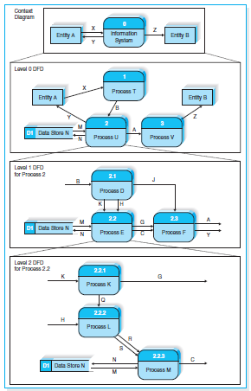
Using Data Flow Diagram to Define Business Processes

Slide 17
Using Data Flow Diagram to Define Business Processes
Context Diagram
The first DFD in every business process model, whether a manual system or a computerized system, is the context diagram.
The context diagram shows the entire system in the context with its environment.
All process models have one context diagram
The context diagram shows the overall business process as just one process (i.e., the system itself) and shows the data flows to and from external entities

Slide 18
Using Data Flow Diagram to Define Business Processes
Level 0 Diagram (Level 0 DFD)
Level 0 diagram shows all the processes at the first level of numbering(i.e., processes numbered 1 through 3), the data stores, external entities, and data lows among them.
The purpose of the level 0 DFD is to show all the major high-level processes of the system and how they are interrelated
All process models have one and only one level 0 DFD
Another key priciple in creating sets of DFDs is balancing
Balancing means ensuring that all information presented in a DFD at one level is accurately represented in the next-level DFD

Slide 19
Using Data Flow Diagram to Define Business Processes
Level 1 Diagram (Level 1 DFD)
Each process on the level 0 DFD can be decomposed into more explicit DFD, called level 1 diagram or level 1 DFD, which shows how it operates in greater detail.
In general, all process models have as many level 1 diagram as there are processes on the level 0 diagram; every process in the level 0 DFD would be decomposed into its own level 1 DFD.
The process in level 1 DFD are numbered on the basis of the process being decomposed.
For example, if we are decomposing process 2, and there are three level 1 DFD, so the process in this level 1 DFD are numbered 2.1, 2.2 and 2.3

Slide 20
Using Data Flow Diagram to Define Business Processes
Level 2 Diagram (Level 2 DFD)
Each process on the level 1 DFD can be decomposed into more explicit DFD, called level 2 diagram or level 2 DFD, which shows how it operates in greater detail.
In general, all process models have as many level 2 diagram as there are processes on the level 1 diagram; every process in the level 1 DFD would be decomposed into its own level 2 DFD.
The process in level 2 DFD are numbered on the basis of the process being decomposed.
For example, if we are decomposing process 2.2, and there are three level 2 DFD, so the process in this level 2 DFD are numbered 2.2.1, 2.2.2 and 2.2.3

Slide 21
Process Descriptions
The purpose of the process description is to explain what the process does and provide additional information that the DFD does not provide.
Three techniques are commonly used to describe processing logic : structured English, decision trees, and decision tables.
Structured English uses short sentences to describe the work that a process performs.
Decision trees display decision logic (IF statements) as a set of nodes (questions) and branches (answer).
Decision tables represent complex policy decisions as rules that link various conditions with actions.

Slide 22
Introduction Creating DFD
Data flow diagrams start with the information in the use cases and the requirements definition.
The DFDs typically are created by the project team and reviewed by the users.
Project teams usually use process modeling tools or CASE tools to draw process models.
Simple tools such as Visio are just fancy drawing tools that work like PowerPoint in that they do not understand the syntax or the meaing of DFD elements

Slide 23
Introduction Creating DFD
Other process modeling tools such as BPWin understand the DFD and can perform simple syntax checking to make sure that the DFD is at least somewhat correct.
A full CASE tool, such as Visible Analyst Workbench, provides many capabilities in addition to process modeling.
CASE tools tend to be complex, and while they are valuable for large and complex projects, they often cost more than they add for simple projects.

Slide 24
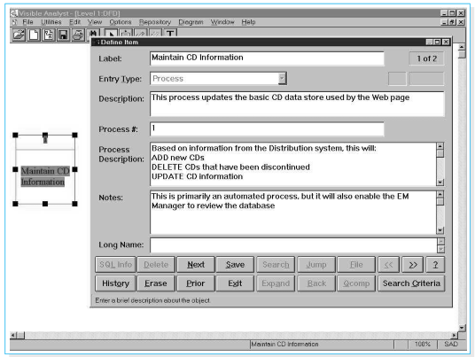
Entering Data Flow Diagram Process in Visible Analyst CASE Tool

Slide 25
Creating the Context Diagram
The context diagram defines how the business process or computer system interacts with its environment – primarily the external entities.
Usually, all inputs and outputs will come from or go to external entities such as a person, organization, or other information system.
If any inputs and outputs connect directly to data stores in an external system, it is best practice to create an external entity which is named for the system that owns the data store.

Slide 26
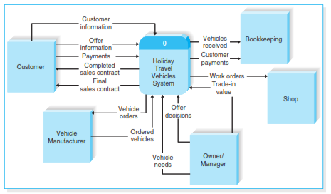
The context Diagram for ther Holiday Travel Vechicles syatem

Slide 27
Creating Data Flow Diagram Fragments
A DFD fragments is one part of a DFD that eventually will be combined with other DFD fragments to form a DFD.
In this step, each use case is converted into one DFD fragment.
Start by taking each use case and drawing a DFD fragment, using the information given on the top of the use case: the name, ID number, and major inputs and outputs

Slide 28
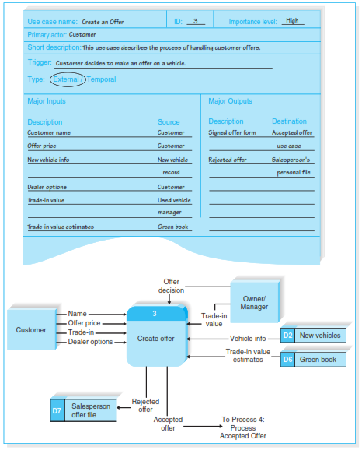
Holiday Travel Vehicles Process 3 DFD Fragment

Slide 29
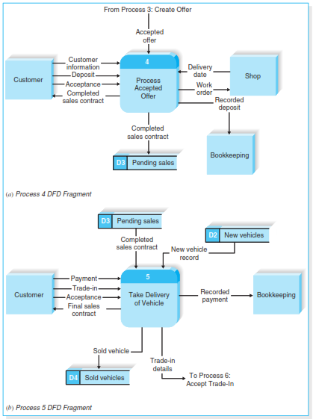
Holiday Travel Vehicles Process 3 DFD Fragment

Slide 30
Creating the Level 0 Data Flow Diagram
Once you have the set of DFD fragments, you simply combine them into one DFD drawing that becomes the level 0 DFD.
There are no formal layout rules for DFD, however, most systems analysts try to put the process that is first chronologically in the upper left corner of the diagram and work their way from top to bottom, left to right

Slide 31
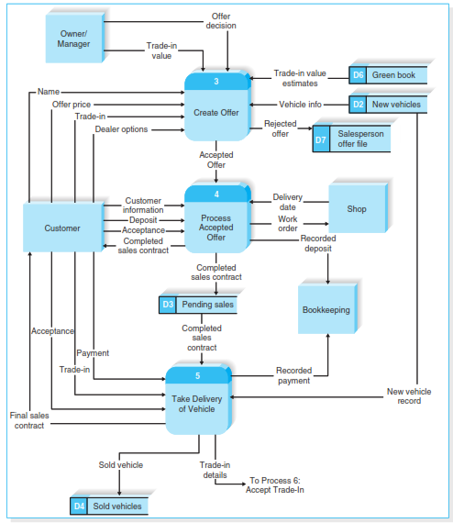
Holiday Travel Vehicles Partial Level 0 DFD

Slide 32
Creating the Level 1 Data Flow Diagram
The team now begins to create lower-level DFDs for each process in the level 0 DFD that needs a level 1 DFD.
The process for creating the level 1 DFDs is to take the steps as written on the use cases and convert them into a DFD in much the same way as for the level 0 DFD.
Usually, each step in the use case becomes a process on the level 1 DFD, with the inputs and outputs becoming the input and output data flows.

Slide 33
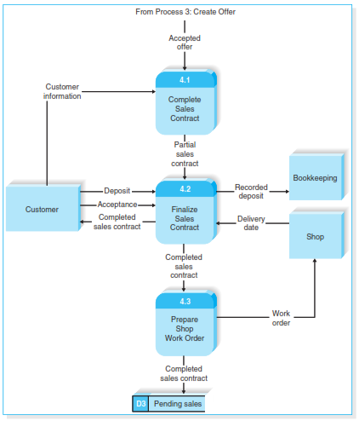
Level 1 DFD for Process Acepted Offer

Slide 34
Validating the Data Flow Diagrams
Once you have created a set of DFDs, it is important to check them for quality.
There are two fundamentally different types of problems that can occur in DFDs : syntax errors and semantics errors.
Syntax refers to the structure of the DFDs and whether the DFDs follow the rules of the DFD languages.
Semantics refers to the meaning of the DFDs and whether the accurately describe the business process being modeled

Slide 35
Introduction ERD
An Entity Relationship Diagram (ERD) is a picture which shows the information that is created, stored, and used by a business system
An Analyst can read an ERD to discover the individual pieces of information in a system and how they are organized and related to each other.
On an ERD, similar kinds of information are listed together and placed inside boxes called entities.
Lines are drawn between entities to represent relationships the data, and special symbols are added to the diagram to communicate high-level business rules that need to be supported by the system.

Slide 36
Reading an Entity Relationship Diagram
The analyst can answer these questions and more by using an entity relationship diagram.
For example, an ERD for the supermarket checkout scenario.
First, we can see that the data to support the checkout process can be organized into four main categories : Item, Sold Item, Sale and Payment.
The Item data describe every product available for sale in the store.
The Sale data capture information about every sale event, and the Payment data describe the payment(s) made for the sale.
The Sold Item data describe every item involved in a specific sale.

Slide 37
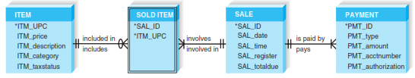
Supermarket ERD

Slide 38
Elements of an ERD
There are three basic elements in the data modeling language, each of which is represented by a different graphic symbol.
  Entity, the basic building block for a data model.
  Attribute, some type of information that is captured about entity
  Relationships, associations between entities

Slide 39
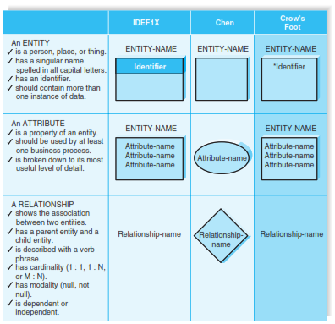
Data Modeling Symbol Sets

Slide 40
Elements of an ERD
  Entity
  The basic building block for a data model
  It is a person, place, event, or thing about which data is collected – for example : an employee, an order, or a product.
  An entity is depicted by a rectangle, and is described by a singular noun spelled in capital letters
  All entities have a name, a short description that explains what they are, and an identifier that is the way to locate information in the entity.

Slide 41
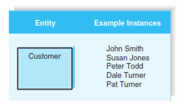
Elements of an ERD
  Entity
  Entities represent something for which there exist multiple instances, or occurances.
  For example, John Smith and Susan Jones could be instances of the customer entity.
Entities and Instances

Slide 42
Elements of an ERD
  Attribute
  An attribute is some type of information that is captures about an entity
  For example, last name, home address, and e-mail address are all attribute of a customer.
  It is easy to come up with hundreds of attributes for an entity ( e.g., a customer has an eye color, a favorite hobby, a religious affiliation), but only those that actually will be used by a business process should be included in the model.
  Attributes are nouns that are listed within an entity

Slide 43
Elements of an ERD
  Relationship
  Relationships are associations between entities, and they are shown by lines that connect the entities together.
  Every relationship has a parent entity and a child entity
  The parent being the first entity in the relationship, and the child being the second
  Relationships should be clearly labeled with active verbs so that the connections between entities can be understood.

Slide 44
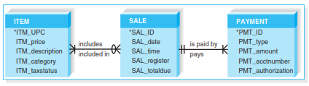
M : N Relationships

Slide 45
The Data Dictionary and Metadata
  Data dictionary is look up information about the entities, attributes, and relationship on the ERD
  The information you see in the data dictionary is called metadata, which quite simply, is data about data.
  Metadata is anything that describes an entity, attribute, or relationship, such as entity names, attribute descriptions, and relationship cardinality, and captured to help designers better understand the system that they are building and to help users better understand the system that they will use.

Slide 46
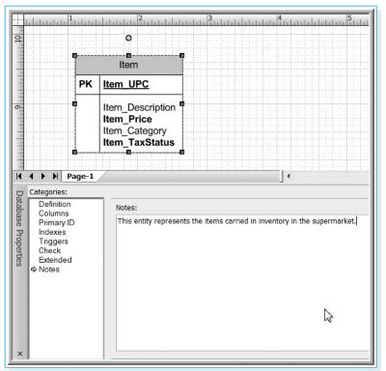
Data Dictionary Description for Item Entity (in Visio 2007)

Slide 47
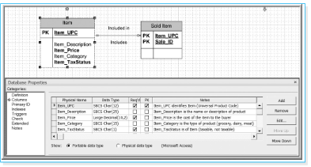
Data Dictionary Description for Item Attributes (in Visio 2007)

Slide 48
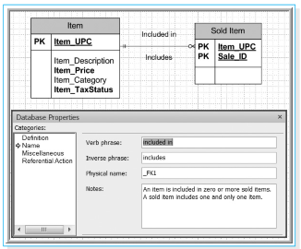
Data Dictionary Description for Item Relationship (in Visio 2007)

Slide 49
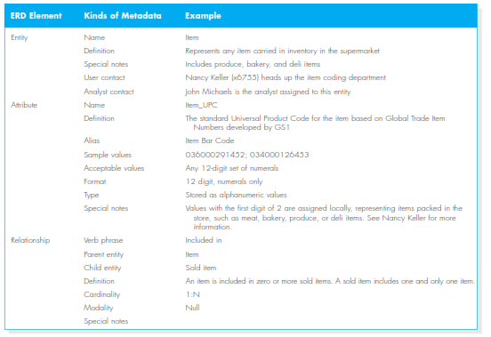
Types of Metadata Captured by the Data Dictionary

Slide 50
Introduction Creating ERD
Drawing an ERD is an interactive process of trial and revision
ERDs can become quite complex – in fact, there are systems that have ERDs containing hundreds or thousands of entities.
The basic steps in building an ERD are these :
  Identify the entities
  Add the appropriate attributes to each entity, and
  Draw relationships among entities to show how they are associated with one another

Slide 51
Building Entity Relationship Diagram
Step 1 : Identify the Entities
The most popular way to start an ERD is to first identify the entities for the model, and their attributes
The entities should represent the major categories of information that you need to store in your system
If the process models (e.g., DFDs) have been prepared, the easiest way to start is with them
The data stores on the DFDs, the external entities, and the data flows indicate the kinds of information that are captures and flow through the system

Slide 52

Building Entity Relationship Diagram
Step 2 : Add Attributes and Assign Identifiers
The information that describes each entity becomes its attributes
For example, a customer has a name and address, and a vecicle has a make and model.
Elements of the Customer Information Data Flow

Slide 53
Building Entity Relationship Diagram
Step 3 : Identify Relationships
The last step in creating ERDs is to determine how the entities are related to each other.
Lines are drawn between entities that have relationships, and each relationship is labeled and assigned both a cardinality and a modality.
The easiest approach is to begin with one entity and determine all the entities with which it shares relationships.

Slide 54
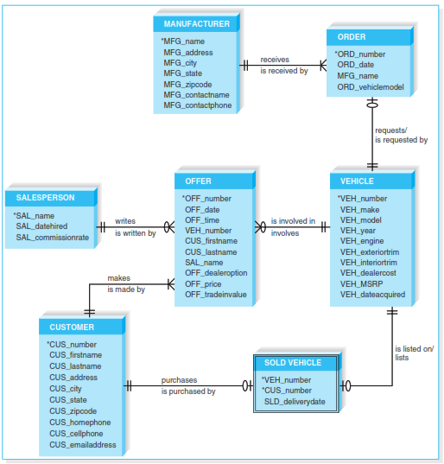
Holiday Travel Vehicles ERD

Slide 55
Advanced Syntax
  Now that we have created a data model according to the basic syntax that was discussed earlier, we can move to several advanced concepts
  There are three special types of entities :
    Independent Entity
    Dependent Entity
    Intersection Entity

Slide 56
Advanced Syntax
    Independent Entity :
    An independent entity is an entity that can exist without the help of another entity, such as manufacturer, vehicle, salesperson, and customer.
    These entities all have identifiers that were created from their own attributes (vehicle number, customer number, manufacturer name)
    Attributes from other entities were not needed to uniquely identify instances of these entities
    For example, the vehicle number is sufficient to uniquely identify vehicles. Information from the order, offer, or sold vehicle entities is not needed to identify a vehicle, even though these entities share relationship with the vehicle entity.

Slide 57
Advanced Syntax
    Independent Entity :
    Independent entities are drawn as rectangles with a single border line
    When a relationship includes an independent child entity, it is called a non-identifying relationship.
    This name is derived from the fact that parent entity attributes are not needed as part of the child entity’s identifier.

Slide 58
Advanced Syntax
    Dependent Entity :
    There are situations when a child entity does require attributes from the parent entity to uniquely identify an instance.
    In these cases, the child entity is called a dependent entity, and its identifier consists of at least one attribute from the parent entity.
    For example, the Sold Vehicle entity is a kind of dependent entity.
    A sold vehicle is a specific vehicle that has been sold to a specific customer.
    To fully identify the Sold Vehicle entity, we use the vehicle number from the Vehicle entity and the customer number from the Customer entity as the sold vehicle identifiers

Slide 59
Advanced Syntax
    Intersection Entity :
    Intersection entity exists in order to capture some information about the relationship between two other entities.
    Typically, intersection entities are added to a data model to store information about two entities sharing an M : N relationship.
    These entities are also called Association Entities.

Slide 60
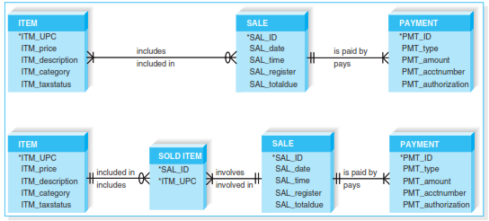
Resolving an M : N Relationship

Slide 61
References
SystemsAnalysis and Design, Dennis, Allan Cs (2015), Fifth Edition, ISBN : 13 978-0-470.22854-8.
What is a Data Flow Diagram, https://www.lucidchart.com/pages/data-flow-diagram
Data Flow Diagram Symbols, Types, and Types, https://www.lucidchart.com/blog/data-flow-diagram-tutorial
Entity Relationship Diagram, https://www.smartdraw.com/entity-relationship-diagram/
What is an Entity Relationship Diagram, https://www.lucidchart.com/pages/er-diagrams

Slide 62
Q & A

